Slide 1

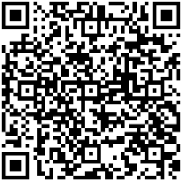
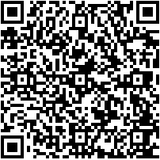
BAIN SEOUL
IS HIRING
ASSOCIATE
CONSULTANT
Seoul 2026 2H AC recruiting
Application Deadline | Tuesday, October 27th, 2026, 10:00AM KST
How to Apply | Apply via Bain official website (Link)
Application Material | English Resume only (Must include your overall GPA)
More Details & FAQs | Please refer to our AC website > Select “Seoul”
Bain AC website:
SCAN TO APPLY
FAQs
For any questions: Recruiting.Seoul@bain.com

Slide 2
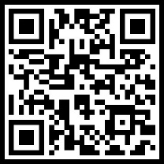
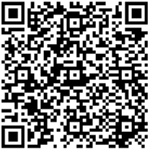
참고
2026.1H 포스터
BAIN SEOUL
IS HIRING
ASSOCIATE
CONSULTANT
Seoul 2026 1H AC recruiting
Application Deadline | Sunday, May 10th, 2026, 11:59PM KST
How to Apply | Apply via Bain official website (Link)
Application Material | English Resume only (Must include your overall GPA)
More Details & FAQs | Please refer to our AC website > Select “Seoul”
Bain AC website:
SCAN TO APPLY
FAQs
For any questions: Recruiting.Seoul@bain.com

